Slide 1


Unit 2
User roles
Notes:
Welcome to Unit 2 of Module 4.

Slide 2
By the end of this unit, you will be able to:
explain key user roles within the HHFA CSPro system
Notes:
By the end of this unit, you will be able to explain key user roles within the HHFA CSPro system.

Slide 3



User roles within the HHFA CSPro system
area supervisor
Team 1
Team 2
Team.. N
team leader
data collector
data collector
team leader
data collector
data collector
Data collection team = team leader + data collectors
Notes:
During the HHFA data collection process, the area supervisor oversees the data collection teams in the geographical area assigned to them.
Each data collection team consists of a team leader and a number of data collectors.

Slide 4
User roles within the HHFA CSPro system
User roles:
area supervisor
team leader
data collector
each role has a set of CSPro functionalities
staff code used to log into HHFA CSPro determines the functionalities available to the user
Notes:
There are 3 main user roles within the HHFA CSPro system related to data collection:
the area supervisor;
the team leader; and
the data collector.
Each of these roles has a set of CSPro functionalities available to them.
The staff code used to log into the HHFA CSPro application will determine the set of functionalities available to the user.
We’ll now look at these functionalities.

Slide 5
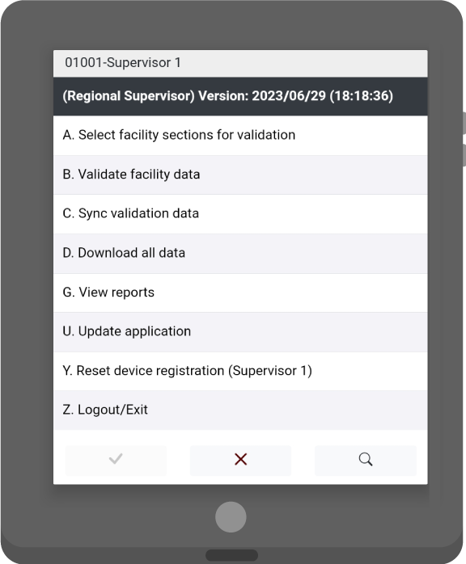
Area supervisor’s role
Responsibility 1: Validate data collectors’ data
select facility sections for validation
validate facility data
sync validated data
Notes:
Area supervisors have 2 main responsibilities.
The first responsibility is the validation of data collectors’ data, which involves revisiting 10% of the surveyed facilities and collecting data for the whole questionnaire, or the selected questionnaire sections.
To do this, they must carry out the following tasks:
select facility sections for validation: this involves selecting the questionnaire sections for which they will collect data. This can be all the questionnaire sections, or just a subset;
validate facility data: they then collect the data for validation; and
sync validated data: this data is synced to the central database.

Slide 6
Area supervisor’s role
Responsibility 2: Track progress versus survey completion
download data
view reports
update the application
reset the device registration, as needed
Notes:
The second responsibility involves tracking progress versus survey completion.
To do this, they must carry out the following tasks:
download data: they must download from the central database all the data collected thus far;
view reports: they then generate some reports which provide information on progress towards completion of the survey.
Area supervisors can also:
update the application; and
reset the device registration, as needed.

Slide 7
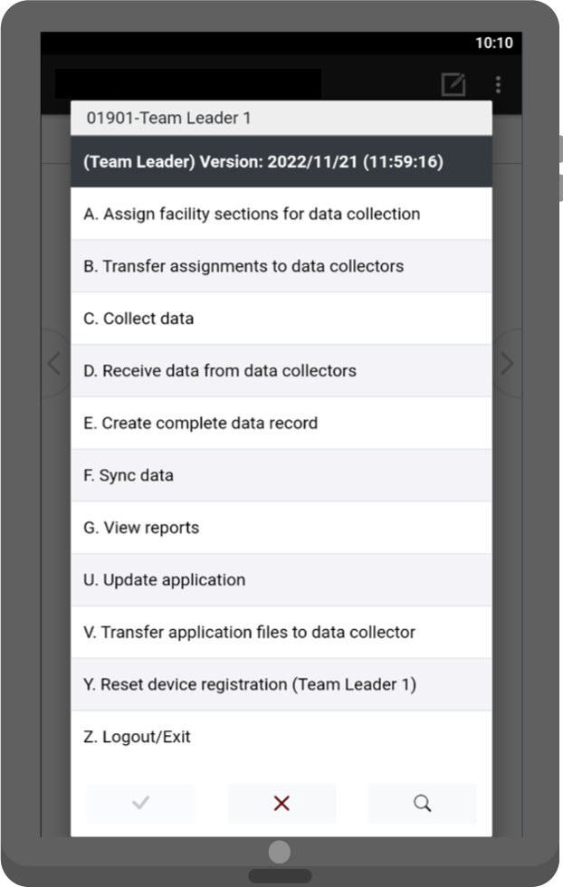
Team leader’s role
Team leaders play a central role in managing data collection in the field.
assign sections
transfer assignments
collect data
receive data from data collectors
create a complete data record
sync data
view reports
Notes:
Team leaders play a central role in managing data collection in the field.
They are responsible for the following tasks:
assign sections for data collection: for each facility, they assign all the required sections of the questionnaire to the data collection team;
transfer assignments to data collectors;
collect data: as team leaders are also data collectors, they must also collect data themselves;
receive data from data collectors: once data collection has been completed for a facility, they receive the data from their team members;
create a complete data record: they then combine the data files of all the data collectors to create a complete facility record;
sync data: next, they ensure the synchronization of the data to the server;
view reports: the “view reports” functionality assists team leaders in tracking progress towards completion for individual facilities as well as across the facilities assigned to them.

Slide 8
Team leader’s role
Team leaders can also:
update the CSPro application
transfer application files to data collectors
reset device registration if needed
Notes:
Team leaders can also:
update the CSPro application as required;
transfer application files to data collectors; and
reset device registration if needed.

Slide 9
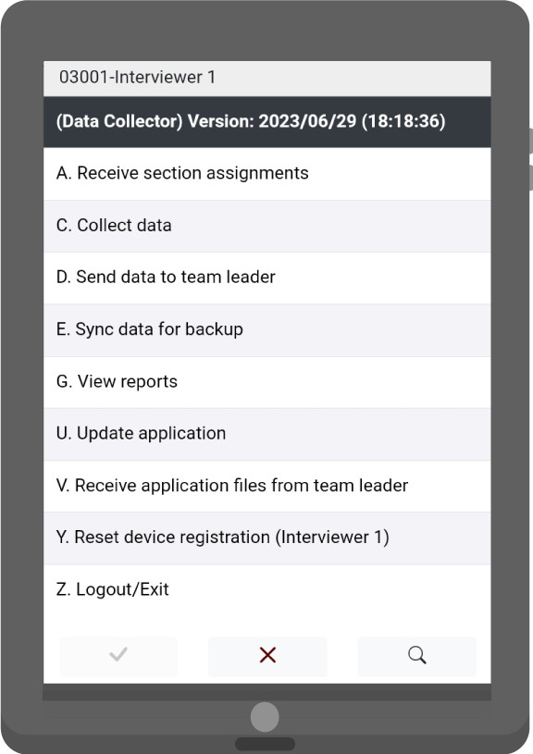
Data collector’s role
Data collectors collect the data for the sections of the questionnaire assigned to them at each facility they visit.
receive section assignments
collect data
send data to team leader
sync data
view reports
Notes:
Data collectors collect the data for the sections of the questionnaire assigned to them at each facility they visit.
They are responsible for the following tasks:
receive section assignments: before starting data collection in a facility, the data collectors must receive, on their devices, the questionnaire sections assigned to them by the team leader;
collect data: they then collect the data for their sections;
send data to team leader: once data collection for a facility is complete, they transfer their completed questionnaire sections to the team leader;
sync data: data collectors are also able to synchronize data to the server for backup;
view reports: this functionality enables each data collector to check that all the questionnaire sections assigned to them are completed.

Slide 10
Data collector’s role
Data collectors can also:
update the application
receive application files from the team leader
reset device registration when needed
Notes:
Data collectors can also:
update the application;
receive application files from the team leader; and
reset device registration when needed.

Slide 11
You have now completed Unit 2.
In the next unit, we will look at the data collection process before arrival at the facility.
First, try the practice exercise.
Notes:
You have now completed Unit 2.
In the next unit, we will look at the data collection process before arrival at the facility.
First, try the practice exercise.

